Slide 1
Roman Civilization
Dr. Md. Faruk Shah
Adjunct Faculty Member
Department of History and Philosophy
North South University

Slide 2

Today’s Lecture Outline
Background
Political history
Government system
Family, education and law system
Gender relations
Science and technological advancement
Rise of Christianity

Slide 3
Background
Ancient Roman culture began in the city of Rome in 753 BC.
Life in ancient Rome revolved around the city of Rome.
It grew to rule much of Europe, Western Asia & Northern Africa.
This was the last city based civilization in Ancient history.
Location made easier for Roman ships to reach other lands.
Contained large plains making it easy to farm.
Close to Mediterranean Sea on several ancient trade routes.
Rome has exercised a great influence upon nearly all modern nations.
https://www.youtube.com/watch?v=GXoEpNjgKzg

Slide 4
Roman Political History and the Govt. System…
Ancient Rome emerged as a group of villages along the Tiber River.
Around 750 B.C. these villages united to form the city of Rome.
For more than 200 years, kings ruled Rome.
In 509 B.C. Rome became a republic.
People elected representatives, known as Senate.
Senates made laws.
Roman General Julius Caesar was a governor of the territory.

Slide 5
Roman Political History and the Govt. System
Roman Senate ordered Caesar to resign but he fought and won.
Established Roman Empire.
Angered Senators stabbed Caesar to death.
Augustus ruled the Roman Empire for more than 40 years.
Soldiers took over most of the land surrounding the Mediterranean.
Created several systems for the welfare of general people.

Slide 6
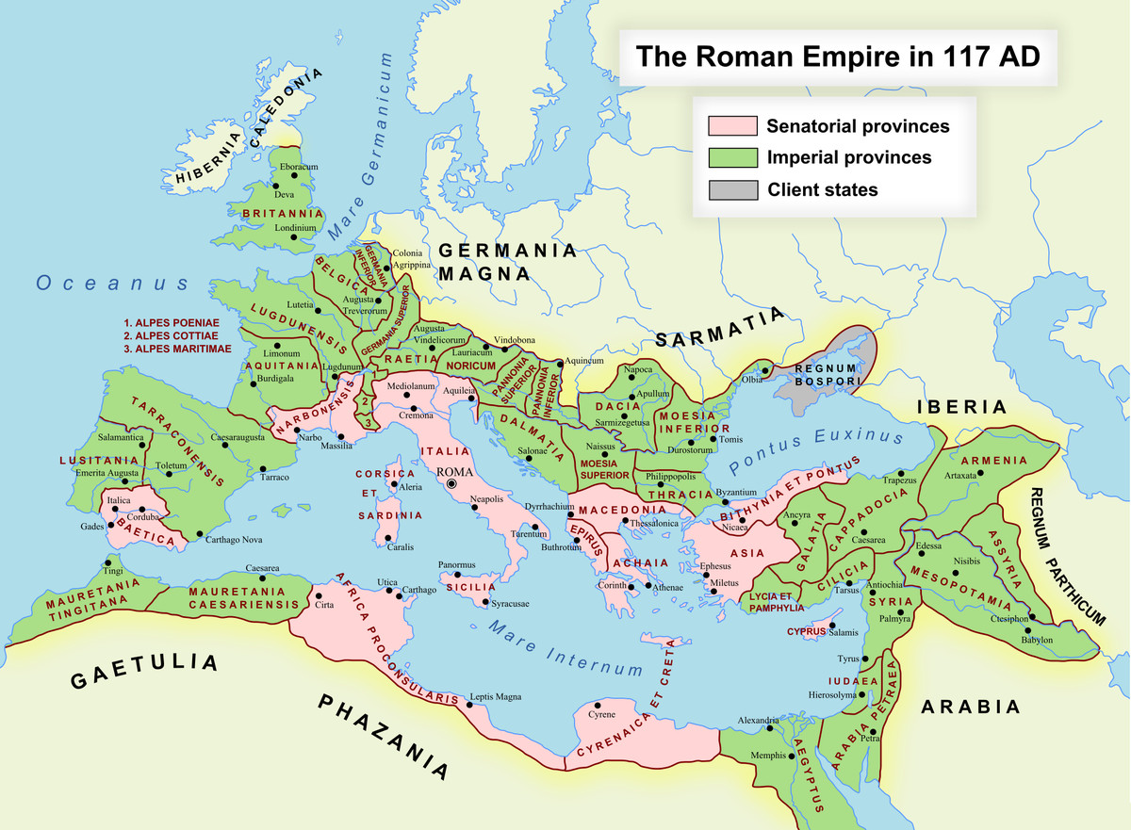
Expansion of Roman Empire

Slide 7
Roman Ancient Religion
Worshipped many gods in private and public ceremonies.
Each household had a shrine devoted to spirits that protected the home and the fields.
Everyday family members gathered to make offerings to Vesta.
Daily rituals taught children to respect and defend the family and its gods.
Public religious festivals and games were dedicated to gods and goddesses.

Slide 8
The Rise of Christianity
After the death of Augustus, Christianity begin to spread.
Introduced a new message to people
By 200 A.D., Christianity spread throughout the empire.
Christians suffered persecution and many were punished or killed.
Christianity became the official religion under Constantine-I.

Slide 9

Social History and Structure
Many aspects of Roman culture were borrowed from the Greeks.
The center of the early social structure was the family.
Slavery and slaves were part of the social order.
There were slave markets where they could be bought and sold.
Source: http://www.theancientworld.net/civ/roman_empire_culture.html

Slide 10
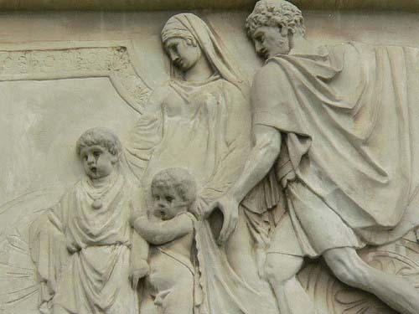
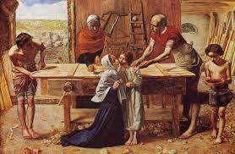
Roman Family System
Extended family was the basic social unit.
Favored large families: for farming and fighting in wars.
Rewarded parents of many children & penalized bachelors.
Father had absolute power over the entire household.
Father imposed strict discipline on their children but fair minded &
ensured family welfare.
Children learnt the responsibilities at an early age.
Parents stressed the virtues of hard work, courage & loyalty.

Slide 11
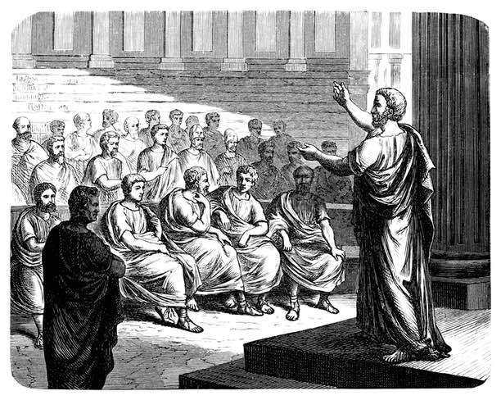
Roman Education
Adapted mainly Greek educational practices.
Home was often the learning center: Roman law, customs &
physical training needed to be recruited into army.
Imported Greek tutors to teach.
By the age of 12, children would be learning Latin, Greek, grammar & literature, followed by training for public speaking.
Education emphasized history.
Stories of Roman heroes gave children a sense of pride.
Girls received instruction from mothers in the art of spinning, weaving & sewing.

Slide 12
Women in the Society
Women had few legal rights.
Fathers usually arranged marriages at 14.
Women gained greater rights as they controlled own property.
Some women also owned businesses.
Women could attend the theater and join in public festivals.
Shared in household decisions & kept the family accounts.
Supervised the children and any slaves owned by the family.

Slide 13
Roman Economic Condition
Economy based on agriculture, trade & industry.
Manufactured goods: pottery, metal goods, glass, wine, olive oil & food products.
Economic growth fostered because of trade routes.
Rome traded across the world.
Rome traded grain, silk, spices, gold & silver.
Roman Military provided trade supports: roads, the access to the sea, etc.
https://www.youtube.com/watch?v=OBfag9O8jCw

Slide 14
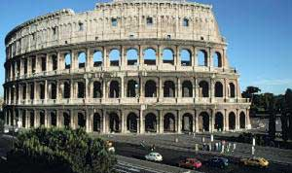
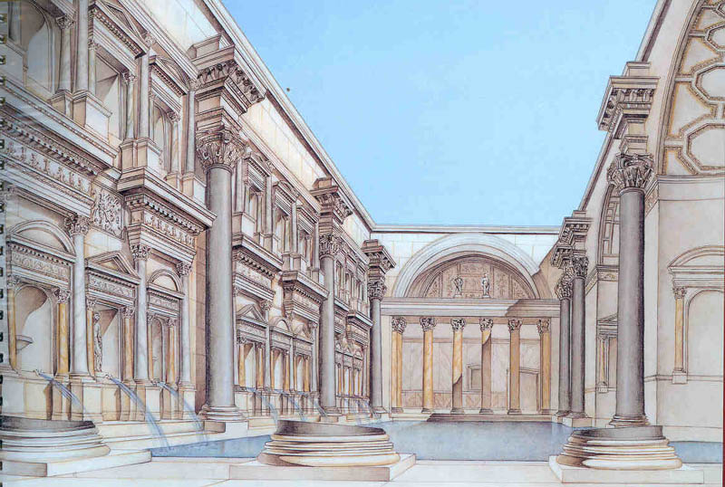
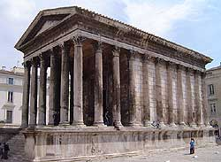
Ancient Rome’s Architecture…
Adopted certain aspects of Ancient Greek for creating a new architectural style.
Wealth and high population forced to discover new solutions of their own.
Used vaults, arches & a sound knowledge of building material for construction.
Intended that public buildings should be made to impress & perform public function.
Roman architecture was very elegant.
Emperors erected solid and richly decorated monuments to symbolize Roman strength.
zqqqqqqq

Slide 15
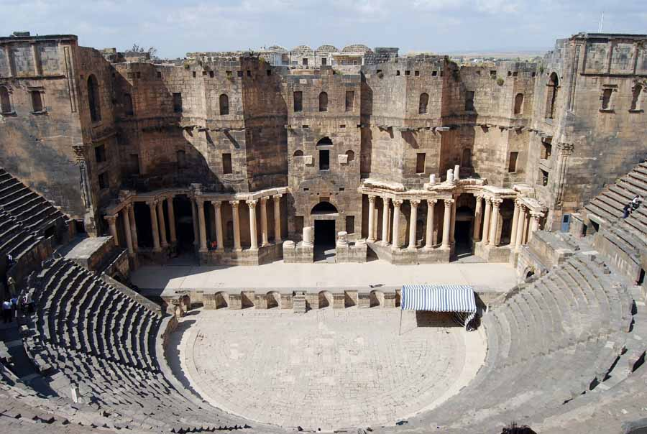

Slide 16
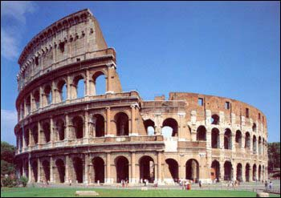
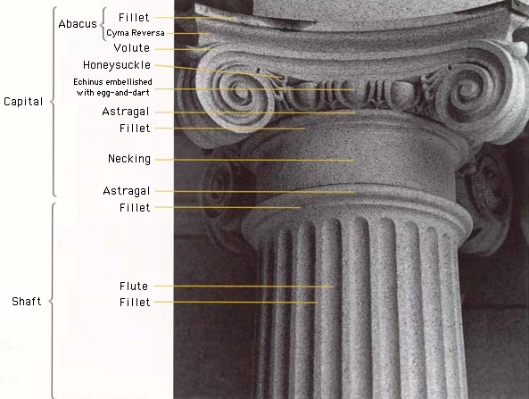
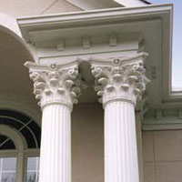
Ancient Rome’s Architecture
Doric Style Ionic Style Corinthian Style
https://www.youtube.com/watch?v=JvPBObPT0LE
https://www.youtube.com/watch?v=Hs45O_sO3r4

Slide 17
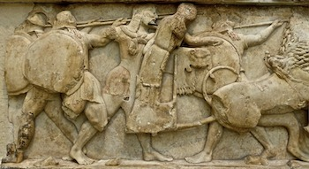
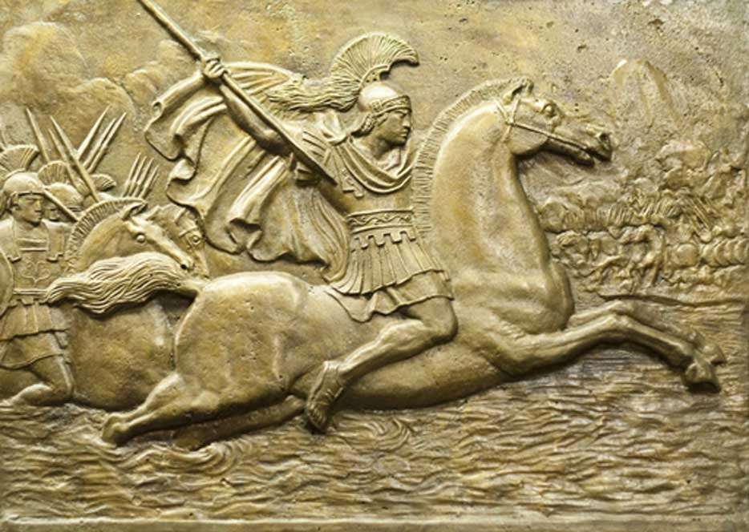
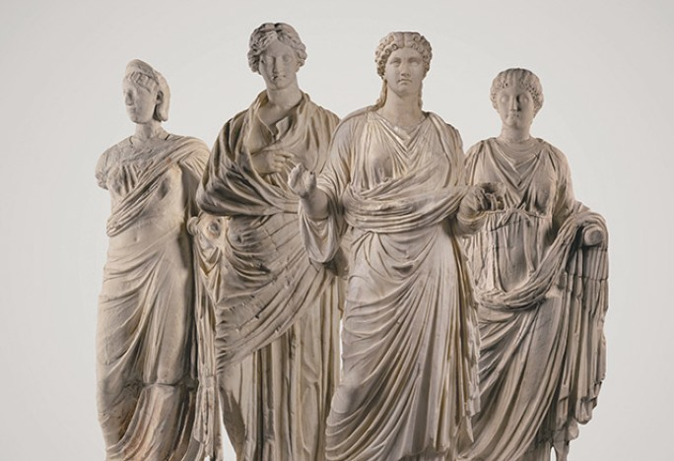
Roman Sculpture
When the Romans conquered Greece, they shipped home thousands of Greek statues.
Greek sculptors idealized the human form, using athletes as models of perfection.
Romans created more realistic portraits.
Sculptors developed their own style.

Slide 18
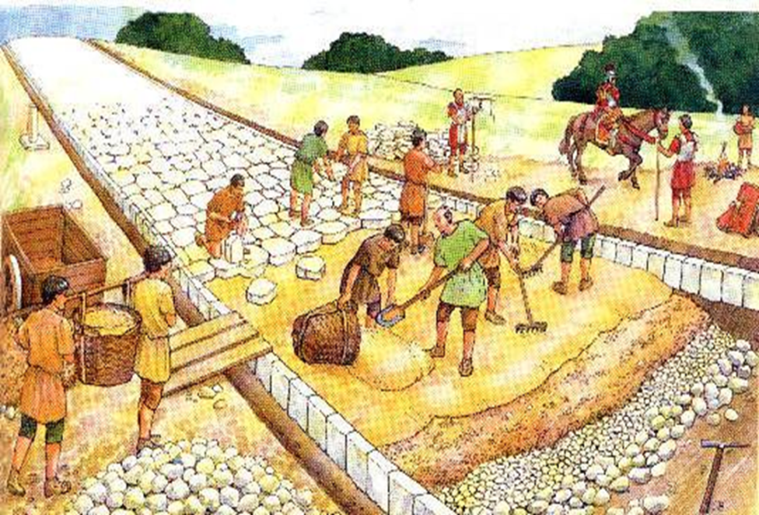
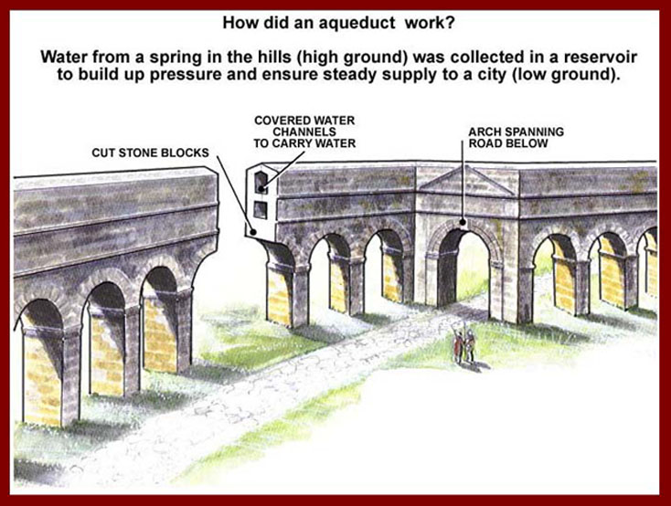
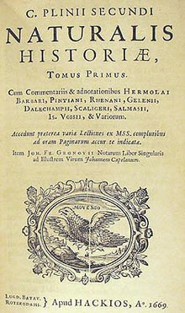
Roman Science and Technology
Applied technical knowledge to many practical concerns.
Plini produced ‘Natural History’ focusing on medicine,
geography & botany.
Built strong bridges to span turbulent rivers.
Designed roads to last forever in the Ancient World.
Roads were built to move soldiers quickly & for trade routes
Roman roads can be seen in parts of Europe today.
Established the idea of water purification by boiling.

Slide 19
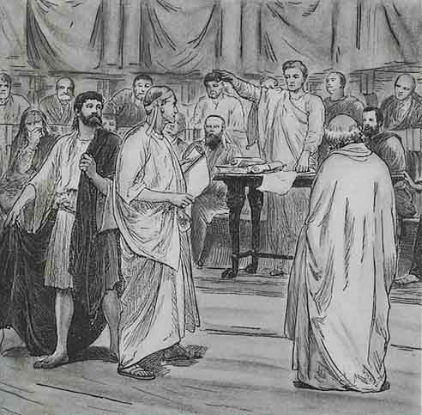
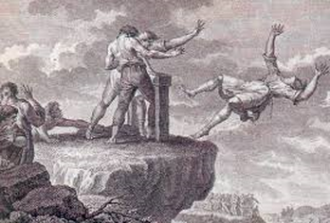
Roman Law
Romans developed a system of law (12 tables).
Roman law established a common standard of justice for all.
Rule for trail: an accused person was considered innocent until proven guilty.
Judges gave verdicts on evidence and witnesses.
Ensured a fair hearing for both sides in a dispute.
Two systems of law: civil law for Roman citizens & law of nations for foreigners.
Two codes were merged into a single law system & applied everywhere.
Roman law system was neutral and liberal in nature.

Slide 20
Roman Arts and Literature
Roman literature was influenced by Greek authors.
Historical epics reflected the early military history of Rome.
Authors produced poetry, comedy, history & tragedy.
Historians: Livy (History of Rome) & Tacituls (Annals)
Music was a major part of everyday life.
https://www.youtube.com/watch?v=lTmlYKiLBHI
Source: http://www.theancientworld.net/civ/roman_empire_culture.html

Slide 21
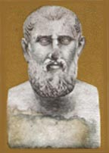
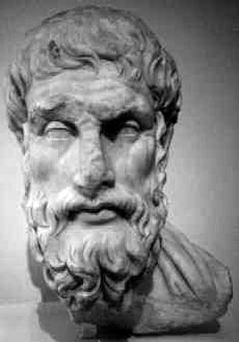
Rome’s Philosophy
Zeno Epicurus
What people should do?
Why people should follow laws and order?
Harmony thru virtue
Achieving Happiness
Decreasing pain is the key
Fear is the worst

Slide 22
The Fall of the Roman Empire
In 476 AD, a Germanic barbarian by the name of Odoacer took control of Rome. He became king of Italy and forced the last emperor of Rome, Romulus Augustulus, to give up his crown.
Social reasons
Economic reasons
Political reasons
The Dark Ages Begins

Slide 23
Thank You and Questions???

